Slide 1

Hampton Roads, Virginia
Newport News EDGE Summit

Slide 2














15 LOCALITIES.
1 REGION.
NEW KENTY COUNTY
JAMES CITY COUNTY
WILLIAMSBURG
YORK COUNTY

Slide 3

OUR MOMENT

Slide 4








“The New Disorder”
COVID-19 Disruptions
Unprecedented Federal Spending
Inflation, Credit Crunch & Rising Interest Rates
Wars in Ukraine & Israel/Gaza
Rising Tensions with China/Iran
Renewed Calls for Racial Justice
The Climate Crisis – Energy Security
Remote
Work, Artificial Intelligence
“The pandemic, and now geopolitical upheaval, have taken the economy and shaken it up like a snow globe. The flakes will eventually fall – there will be a new equilibrium – but things may be arranged differently when everything settles.”
Jeanna Smialek, New York Times, March 25, 2022

Slide 5
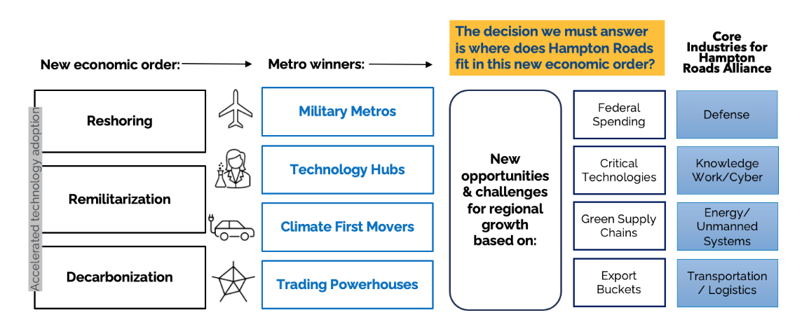
Hampton Roads Where America’s Future Comes Home

Slide 6
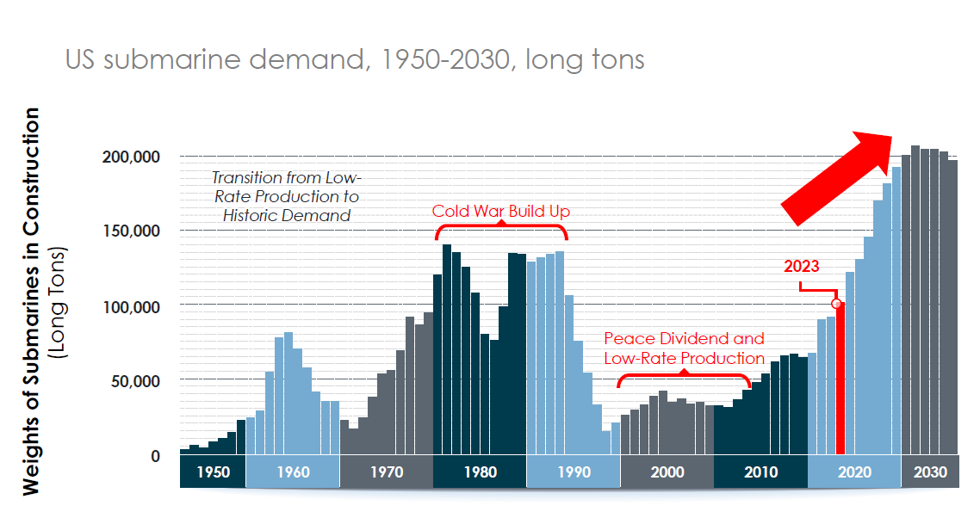
Demand on defense industrial base is at an all time high

Slide 7
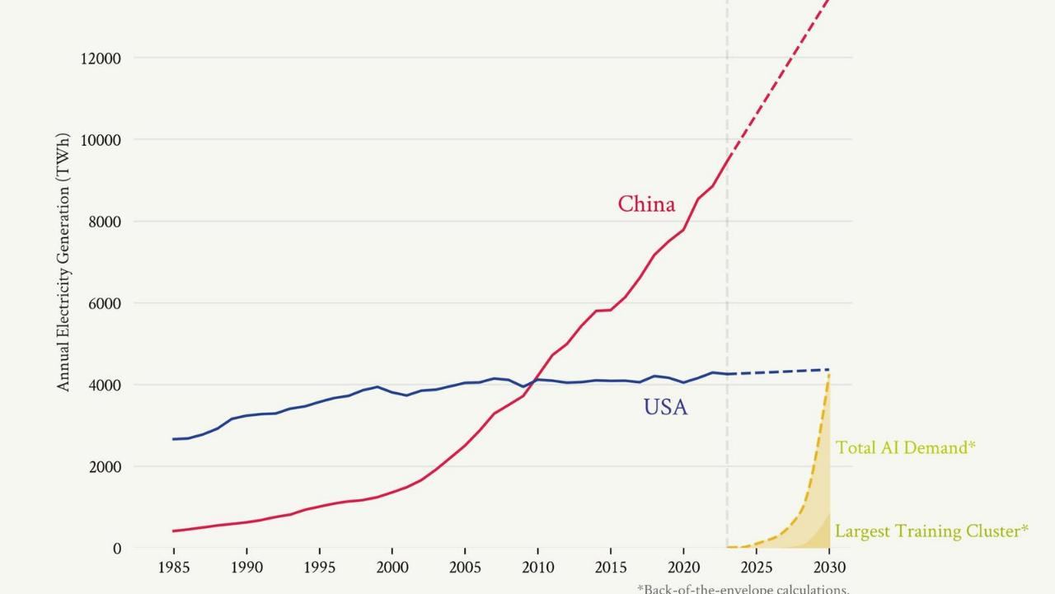
USA vs China Electrical Power Generation

Slide 8
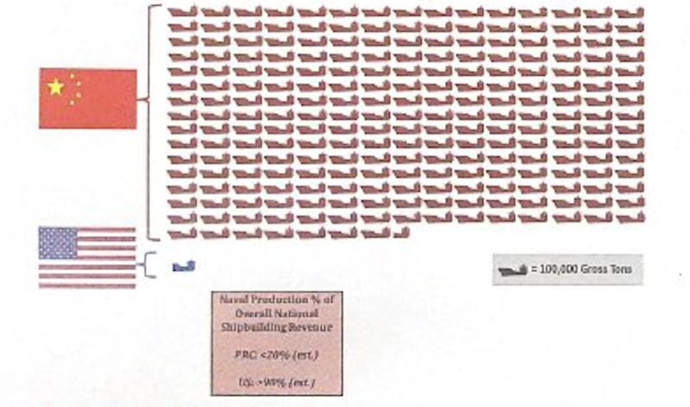
China vs US Shipbuilding Capacity China’s shipbuilding capacity is 232x that of the United States

Slide 9

The National Defense Industrial Strategy (NDIS) provides a roadmap for Hampton Roads
Stated Priorities
Resilient supply chains
Workforce readiness
Flexible acquisition
Economic deterrence

Slide 10
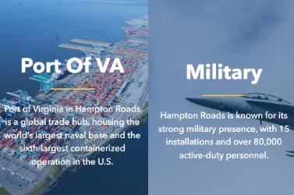

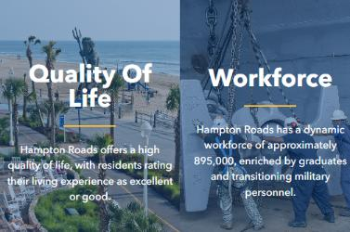




Hampton Roads: The center of Virginia’s World Class Maritime & Defense HUB
Home to 1.8 million people (including Richmond the population is 3+ million) with a labor force of over 866,000
Younger, more diverse, and more educated than the national average
Just 2 ½ hours south of Washington DC
Home to over 200+ international companies and the world’s largest maritime and defense industrial base
Large and talented workforce
Specialized education and training programs from high school to universities

Slide 11
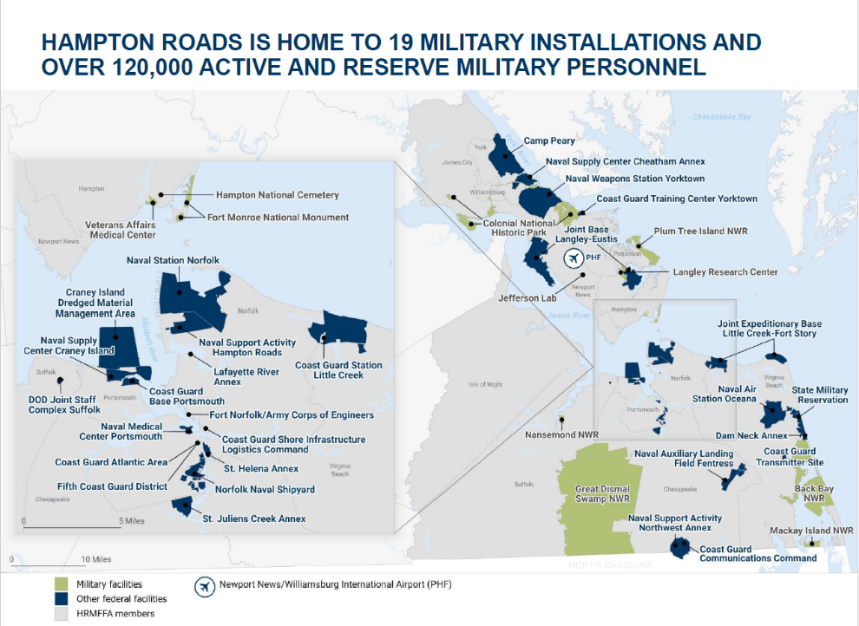

Slide 12






140,000 UNIFORMED and Civilian PERSONNEL 1 in 7 of our residents is a veteran
15,000+
Service Members
Exit the military each year
in Hampton Roads
Source: DoDSkillBridge, 2020

Slide 13

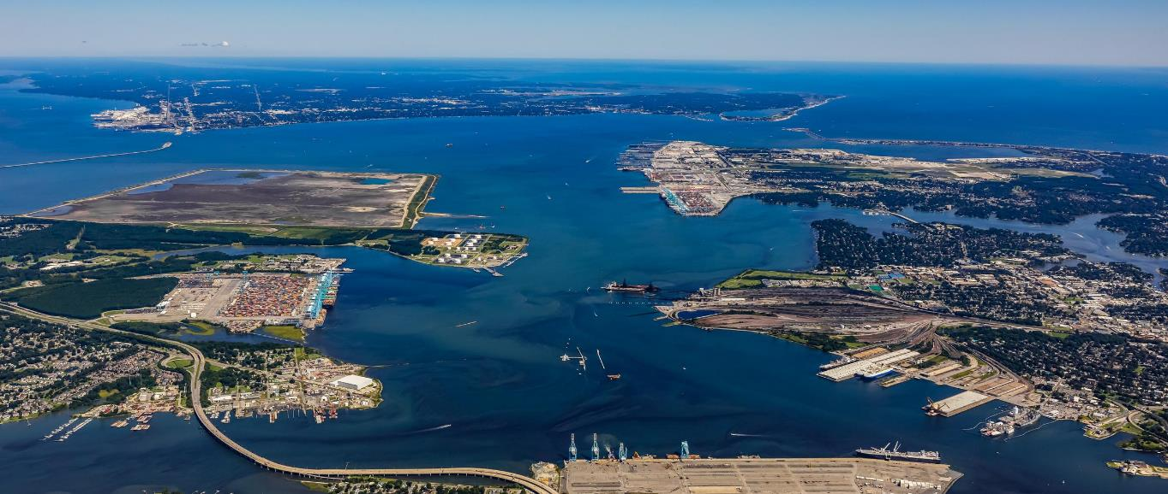
The Port of Virginia
The Gateway to Global Trade and Innovation

Slide 14
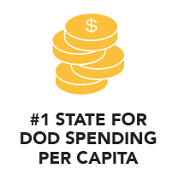





HAMPTON ROADS UNITED BY DEFENSE, STRENGTHENED BY GLOBAL DIVERSITY

Slide 15
Unparalleled access to Federal Government Decision Makers
Every branch of the armed services is in Hampton Roads.
Naval Air Station Oceana (East Coast’s Master Jet Base)
Home to 16 squadrons and the F-18 Super Hornet. Entire property is 6,000 acres with 250 aircraft.
CIA – Campy Perry (9,000 acres) and Harvey Point in NC
Armed Forces Experimental Training Activity. Known as “The Farm” to the CIA.
Yorktown Naval Weapons Station
Weapons and ammo storage. Hosts 25 tenant commands
Joint Expeditionary Base Little Creek-Fort Story
Major operating base for the Amphibious Forces in the United States Navy's Atlantic Fleet.
Home to Seal Team 2,4,8,10.
Fifth Coast Guard District – NJ to SC including protecting Washington DC
Source: DoDSkillBridge, 2020

Slide 16


NATO’S NORTH AMERICAN HEADQUARTERS
A Nexus of Global Defense and Cultural Diversity
Allied Command Transformation, NATO’s Strategic Warfare Development Command
Joint Force Command – Defends NATO territory from Florida to Finnmark, the Tropic of Cancer to the North Pole and from Seabed To Space
Combined Joint Operations from the Sea Center for Excellence
32 member countries based in the region

Slide 17








Regional Technology Assets Technology Assets That Drive Global Competitiveness
Jefferson Lab
NASA Langley Research Center & NASA Wallops Island Spaceport
Lockheed Martin Center for Innovation
Virginia Institute for Spaceflight & Autonomy
Virginia Modeling, Analysis, & Simulation Center Tech Center Research Park
Newport News Air Commerce Park

Slide 18
Levels of Institutional Trust Long term relationships, reliability & global trade
Security Agreements
Trade Agreements
NATO - 32 member states
AUKUS – Australia, UK, United States
ANZUS Treaty – security agreement between Australia, New Zealand and the United States
The Quad – Australia, India, Japan, and the United States
The Five Eyes - Australia, Canada, New Zealand, the United Kingdom, and the United States.
Bilateral Defense Treaties - Japan, South Korea, Philippines, Thailand, Taiwan
USMCA – United States, Mexico, Canada
KORUS – United States, South Korea
US – Australia
CAFTA – DR - United States, Costa Rica, El Salvador, Guatemala, Honduras, Nicaragua, Dominican Republic
US - Singapore FTA
US - Israel FTA
US - Chile FTA
US - Peru FTA
US -Jordan FTA

Slide 19
AUKUS Presents an Opportunity Alliance has entered into MOU’s with Sheffield Region (UK) and South Australia (DTC)
AUKUS Pillar 1 will provide Australia with conventionally armed nuclear-powered submarines
$3 billion investment from Australian government into the US Supply Chain
AUKUS Pillar 2 will develop and provide advanced joint military capabilities to promote security and stability in the Indo-Pacific Region
Key target areas include:
Cyber capabilities
Artificial intelligence
Quantum technologies
Regional assets are perfectly positioned to assist, including:
Jefferson Lab High Performance Data Facility
NASA Langley Research Center & NIA
National Institute of Aerospace
Undersea capabilities
Hypersonic capabilities
Electronic warfare capabilities
Virginia Tech Corporate Research Center
ODU: VMASC, School of Cybersecurity
HII & Lockheed Martin

Slide 20
Federal Spending, Green Supply Chain, and Critical Industries
AREAS OF ANALYSIS – Developing a regional investment playbook

Slide 21
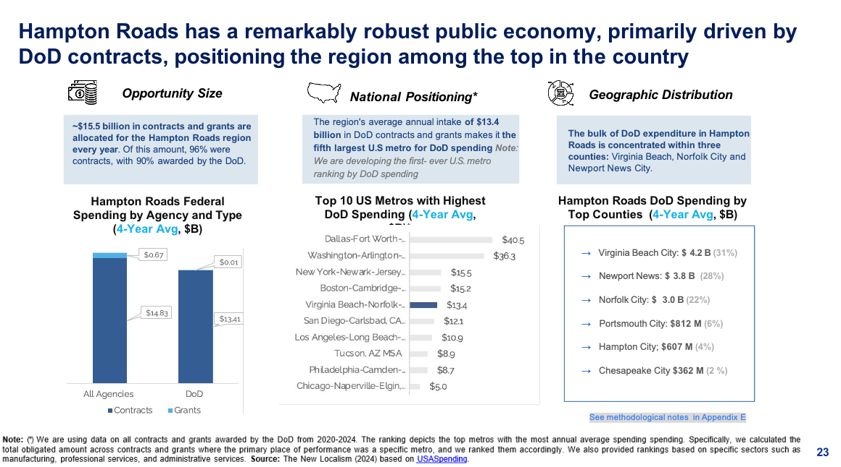

Slide 22
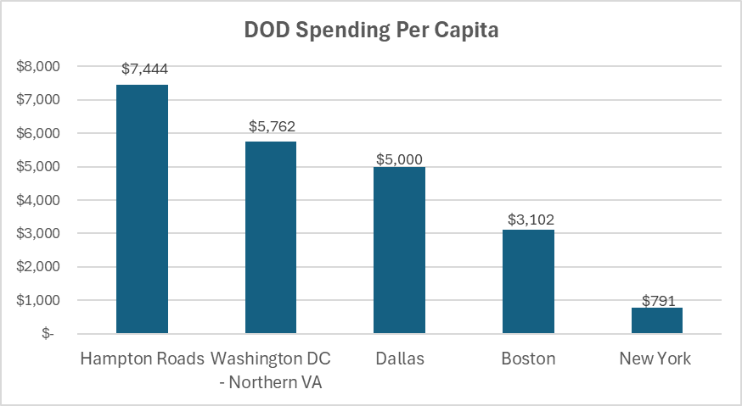
37th largest MSA - #1 DOD Spend Per Capita

Slide 23
Total Federal DOD Contract Spending

Slide 24
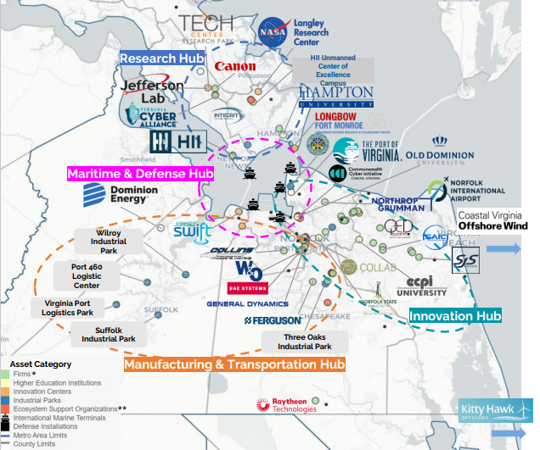
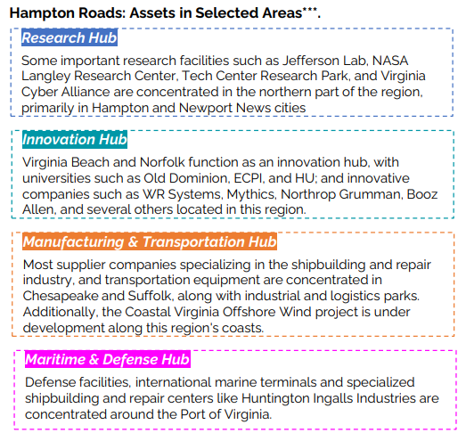
A Constellation of Catalytic Assets

Slide 25
Key Takeaways : Hampton ROAds & Newport News
One of a Kind: No City in the world has the assets of Newport News.
Arsenal of democracy - Only place on earth where nuclear aircraft carriers are built and one of just two shipyards constructing submarines.
Newport News drives breakthroughs in aerospace, maritime and advanced technology.
Newport News exports global security and innovation.
Newport News isn’t just another American city — it’s a strategic, cultural, and natural powerhouse with no rival anywhere in the world.

Slide 26
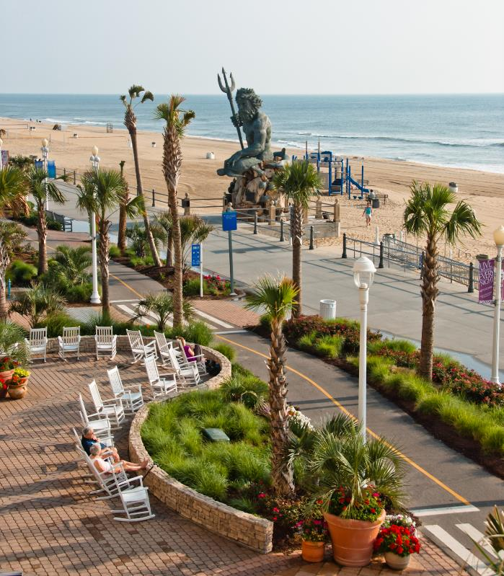



Your Ally in Economic Development.
3 Commercial Place Suite 1320 Norfolk, VA 23510
hamptonroadsalliance.com

